Slide 1
Self Contained Metal Detection System
Team 19
Katherine McManus, Lauren Stiefel, Ragul Ganesh Anitha Palanivel, Aadhi Maalaven Mahesh

Slide 2
Design Requirements
Be battery operated
No lithium based battery technologies
Create an electromagnetic response coil using metallic wire
Calculate resistance and inductance values
Use the BASYS board as the main controller
When a metal is detected:
Indicate size of washer present by lighting a symbol on the board
Count the total number of objects detected
Count the number of times the small, medium and large washer are each detected
Display a strength meter that indicates the strength of the detection signal
Use electronic circuits/microcontrollers/FPGAs to generate waveforms
Use standard electronic components

Slide 3
Our Design Plan
EE:
Generate a sine wave to use as a reference signal
Compare the reference signal to another voltage through an opamp to output a square wave
Voltage divide the output signal if necessary to work with the Basys3 board 3.3V input
See how the values of the signal are affected when a washer is introduced to the inductor
CoE:
Take the values from the output signal of the circuit and designate ranges of values for each size washer
Use the ranges to set the strength meter
Use a proximity measurements to determine if the washer is being detected or not
From the detection measurements, increment the respective sized washers counter

Slide 4
Implementation Block Diagram
Colpitts Oscillator
Test port
OPAMP Analog Comparator
Proximity Sensor
Counter
Voltage Divider
Alarm Timer

Slide 5
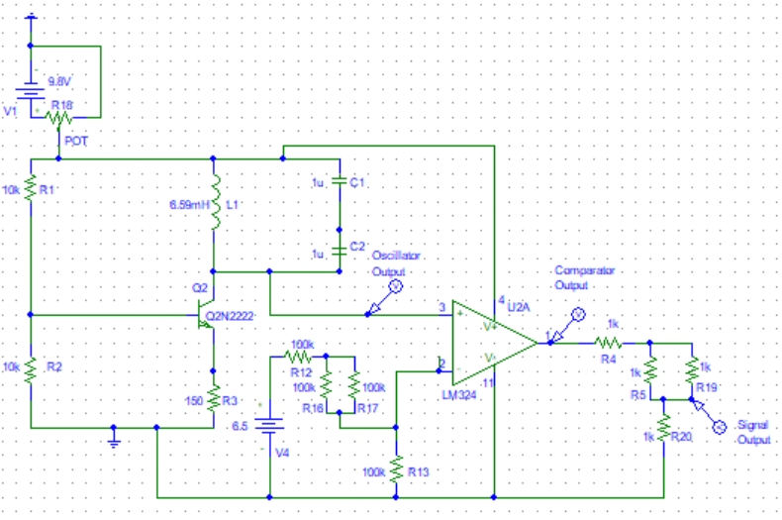
EE Implementation
Colpitts Oscillator
Used to generate a sinusoidal waveform
Uses the inductor and capacitors to determine oscillation frequency
OPAMP Analog Comparator
Compares the peak voltage of the oscillator to a reference voltage of 2.5V
Outputs a square wave
Voltage Divider
Brings the output Voltage down from 8.07V to 3.23V

Slide 6
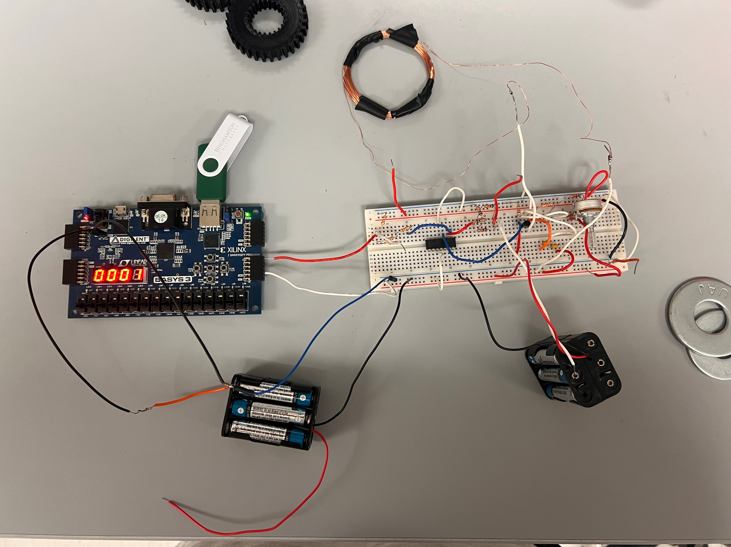
EE Implementation
Analog Comparator
Output Signal Voltage Divider
Colpitts Oscillator

Slide 7
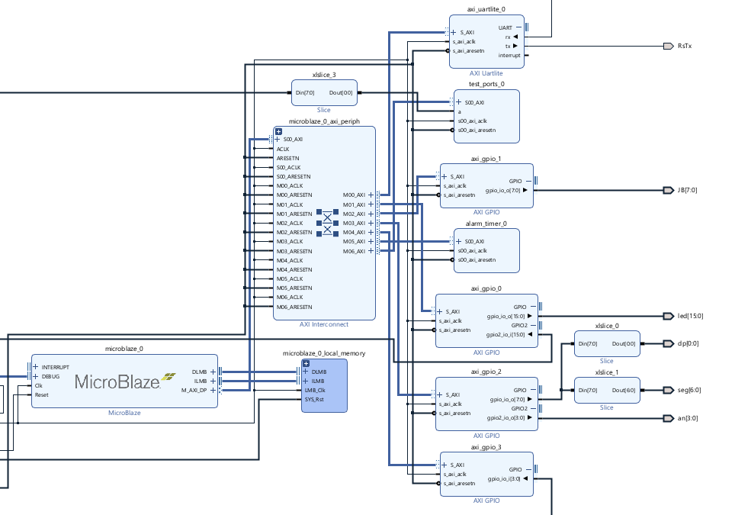
CoE Software Implementation
Test port IP
Samples pwm signal and measures the duty cycle output for the specified time
Alarm Timer
Creates delay specified as the delay unit
Proximity Sensor
Raises a flag for each size metal washer
Counter
Uses flags raised by proximity sensor to increment metal counter

Slide 8
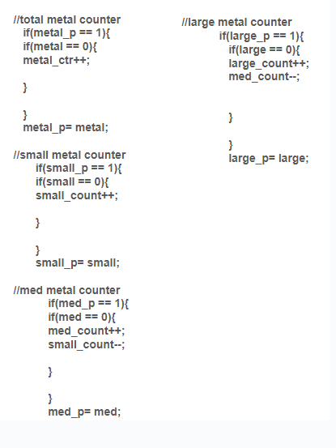
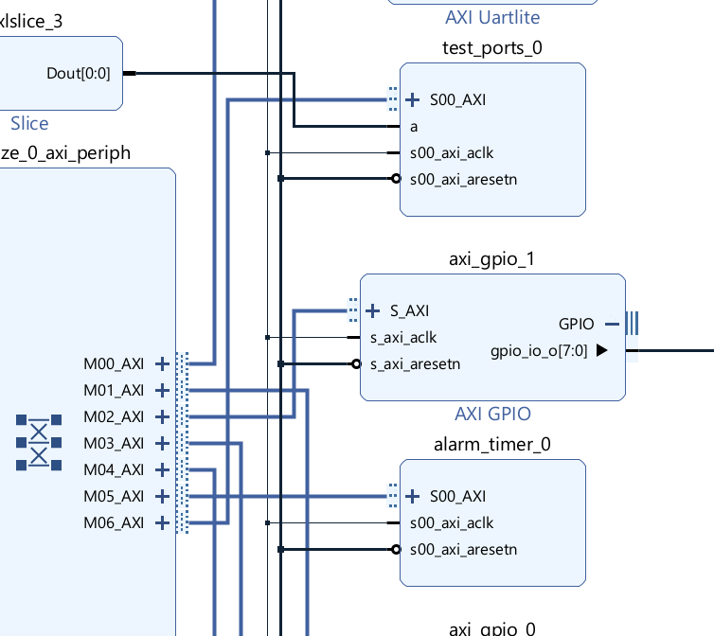
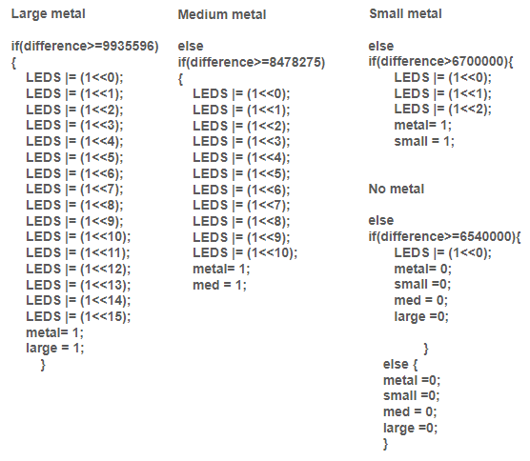
CoE Software Implementation
Test port IP
Counter
Proximity Sensor
Alarm Timer

Slide 9
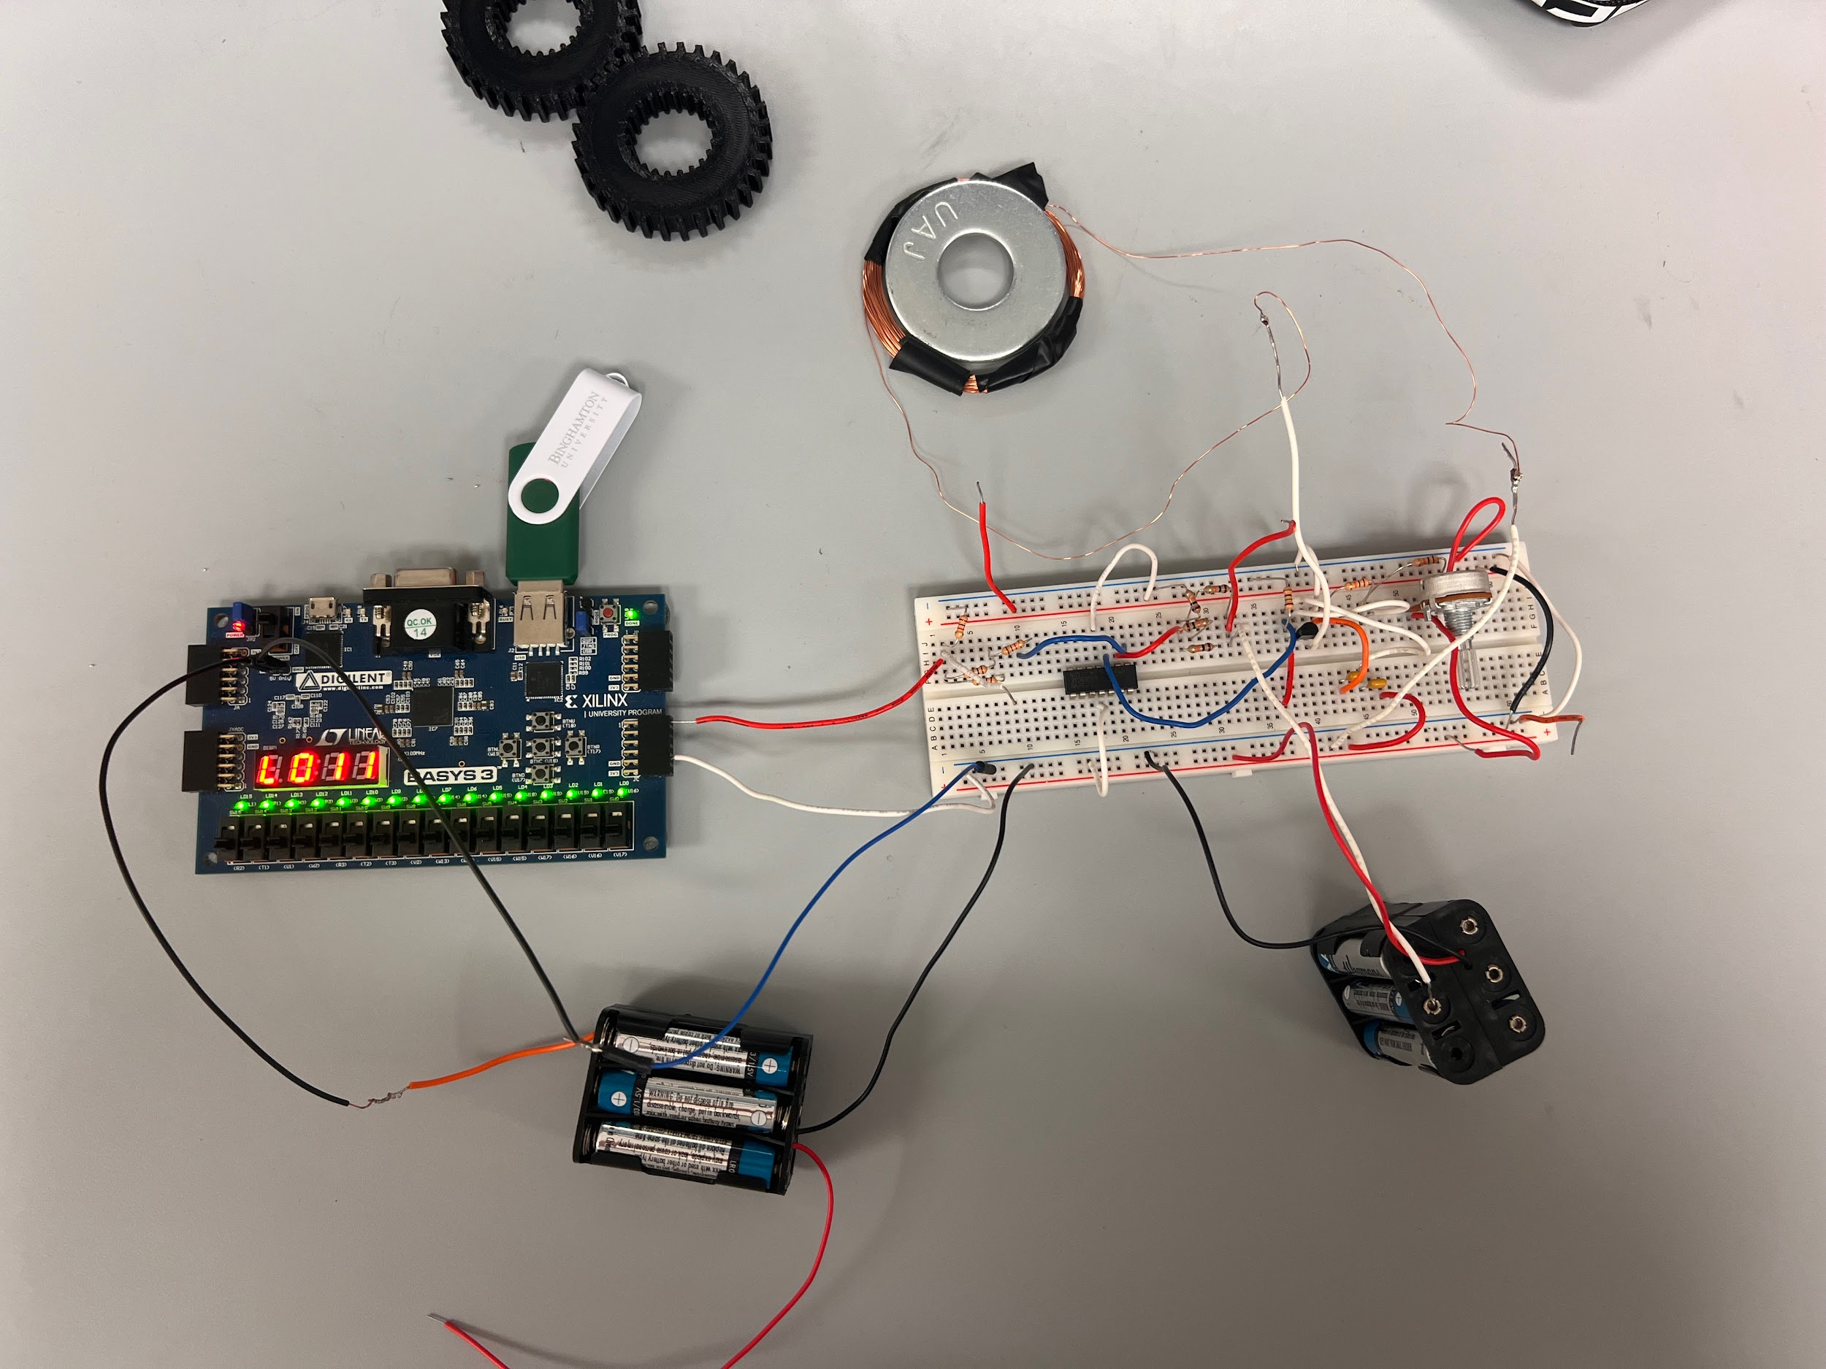
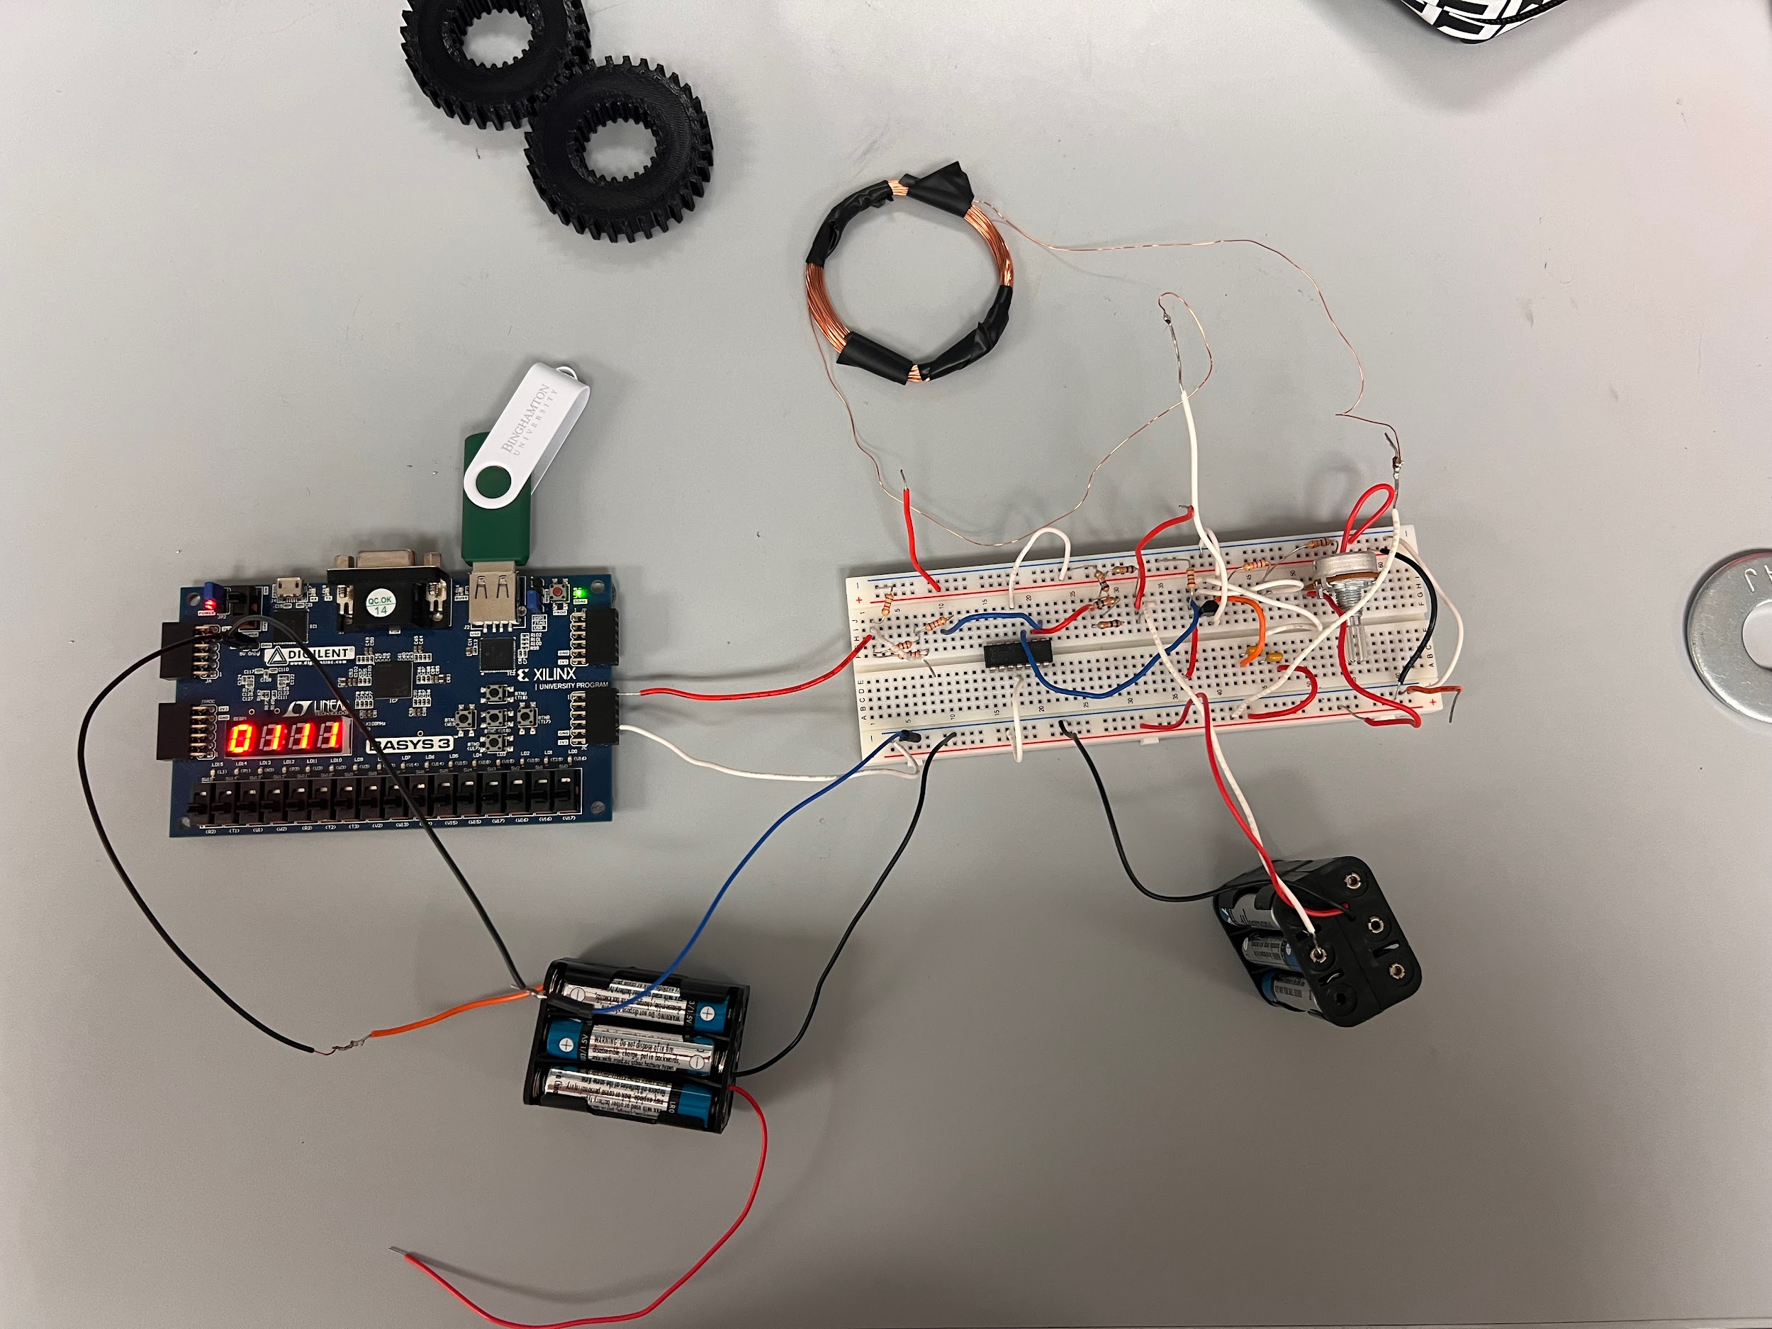
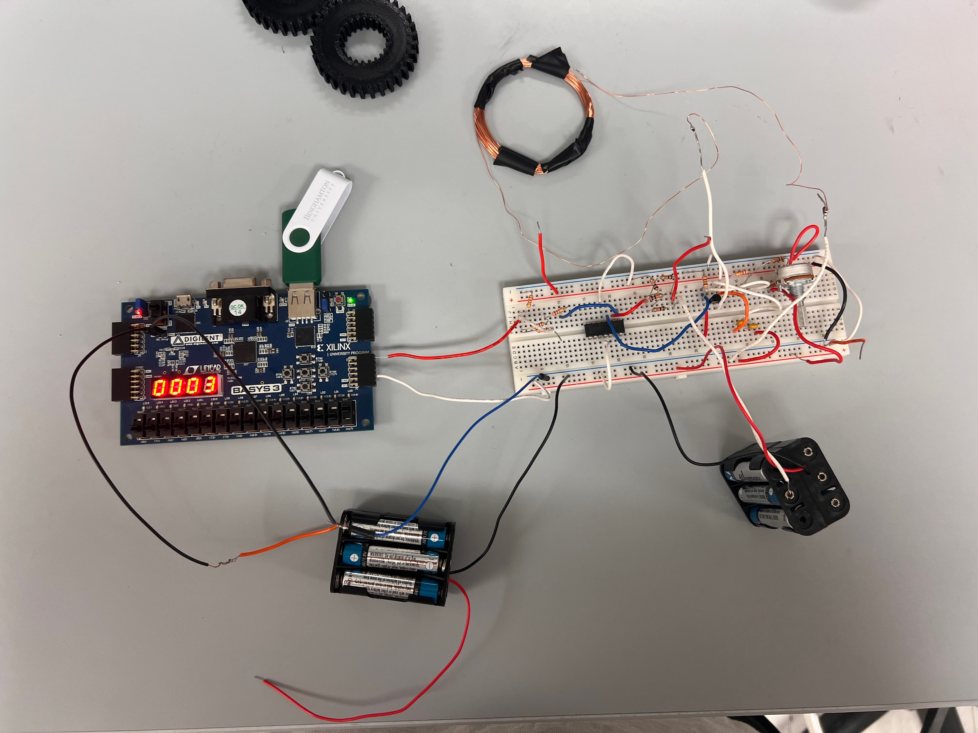
CoE Hardware Implementation
LEDs: shows strength of detection
Leftmost SSEG: displays S, M, or L to indicate size of metal washer
Left Middle SSEG: counts when large washer is detected
Right Middle SSEG: counts when medium washer is detected
Rightmost SSEG: counts when small washer is detected
SW0: when switched on, displays the total number of washers detected

Slide 10
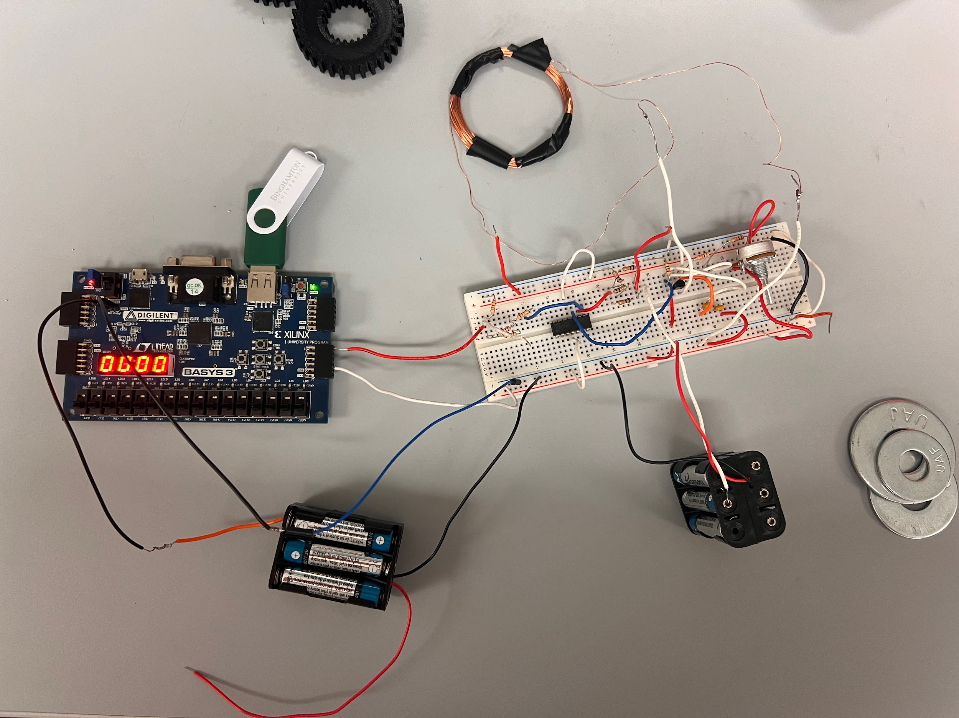
Results
Initial Display
Design was successfully implemented:
Powered only by batteries
Required information is displayed onto Basys3 board
Indicator of size of washer is displayed
Respective counters increment after the washer is removed from the inductor
Total counter totals the number of the washers counted
Strength meter increases and decreases as the strength of the detection changes
Inductor values
L = 6.59 mH
R = 2.99 Ω

Slide 11
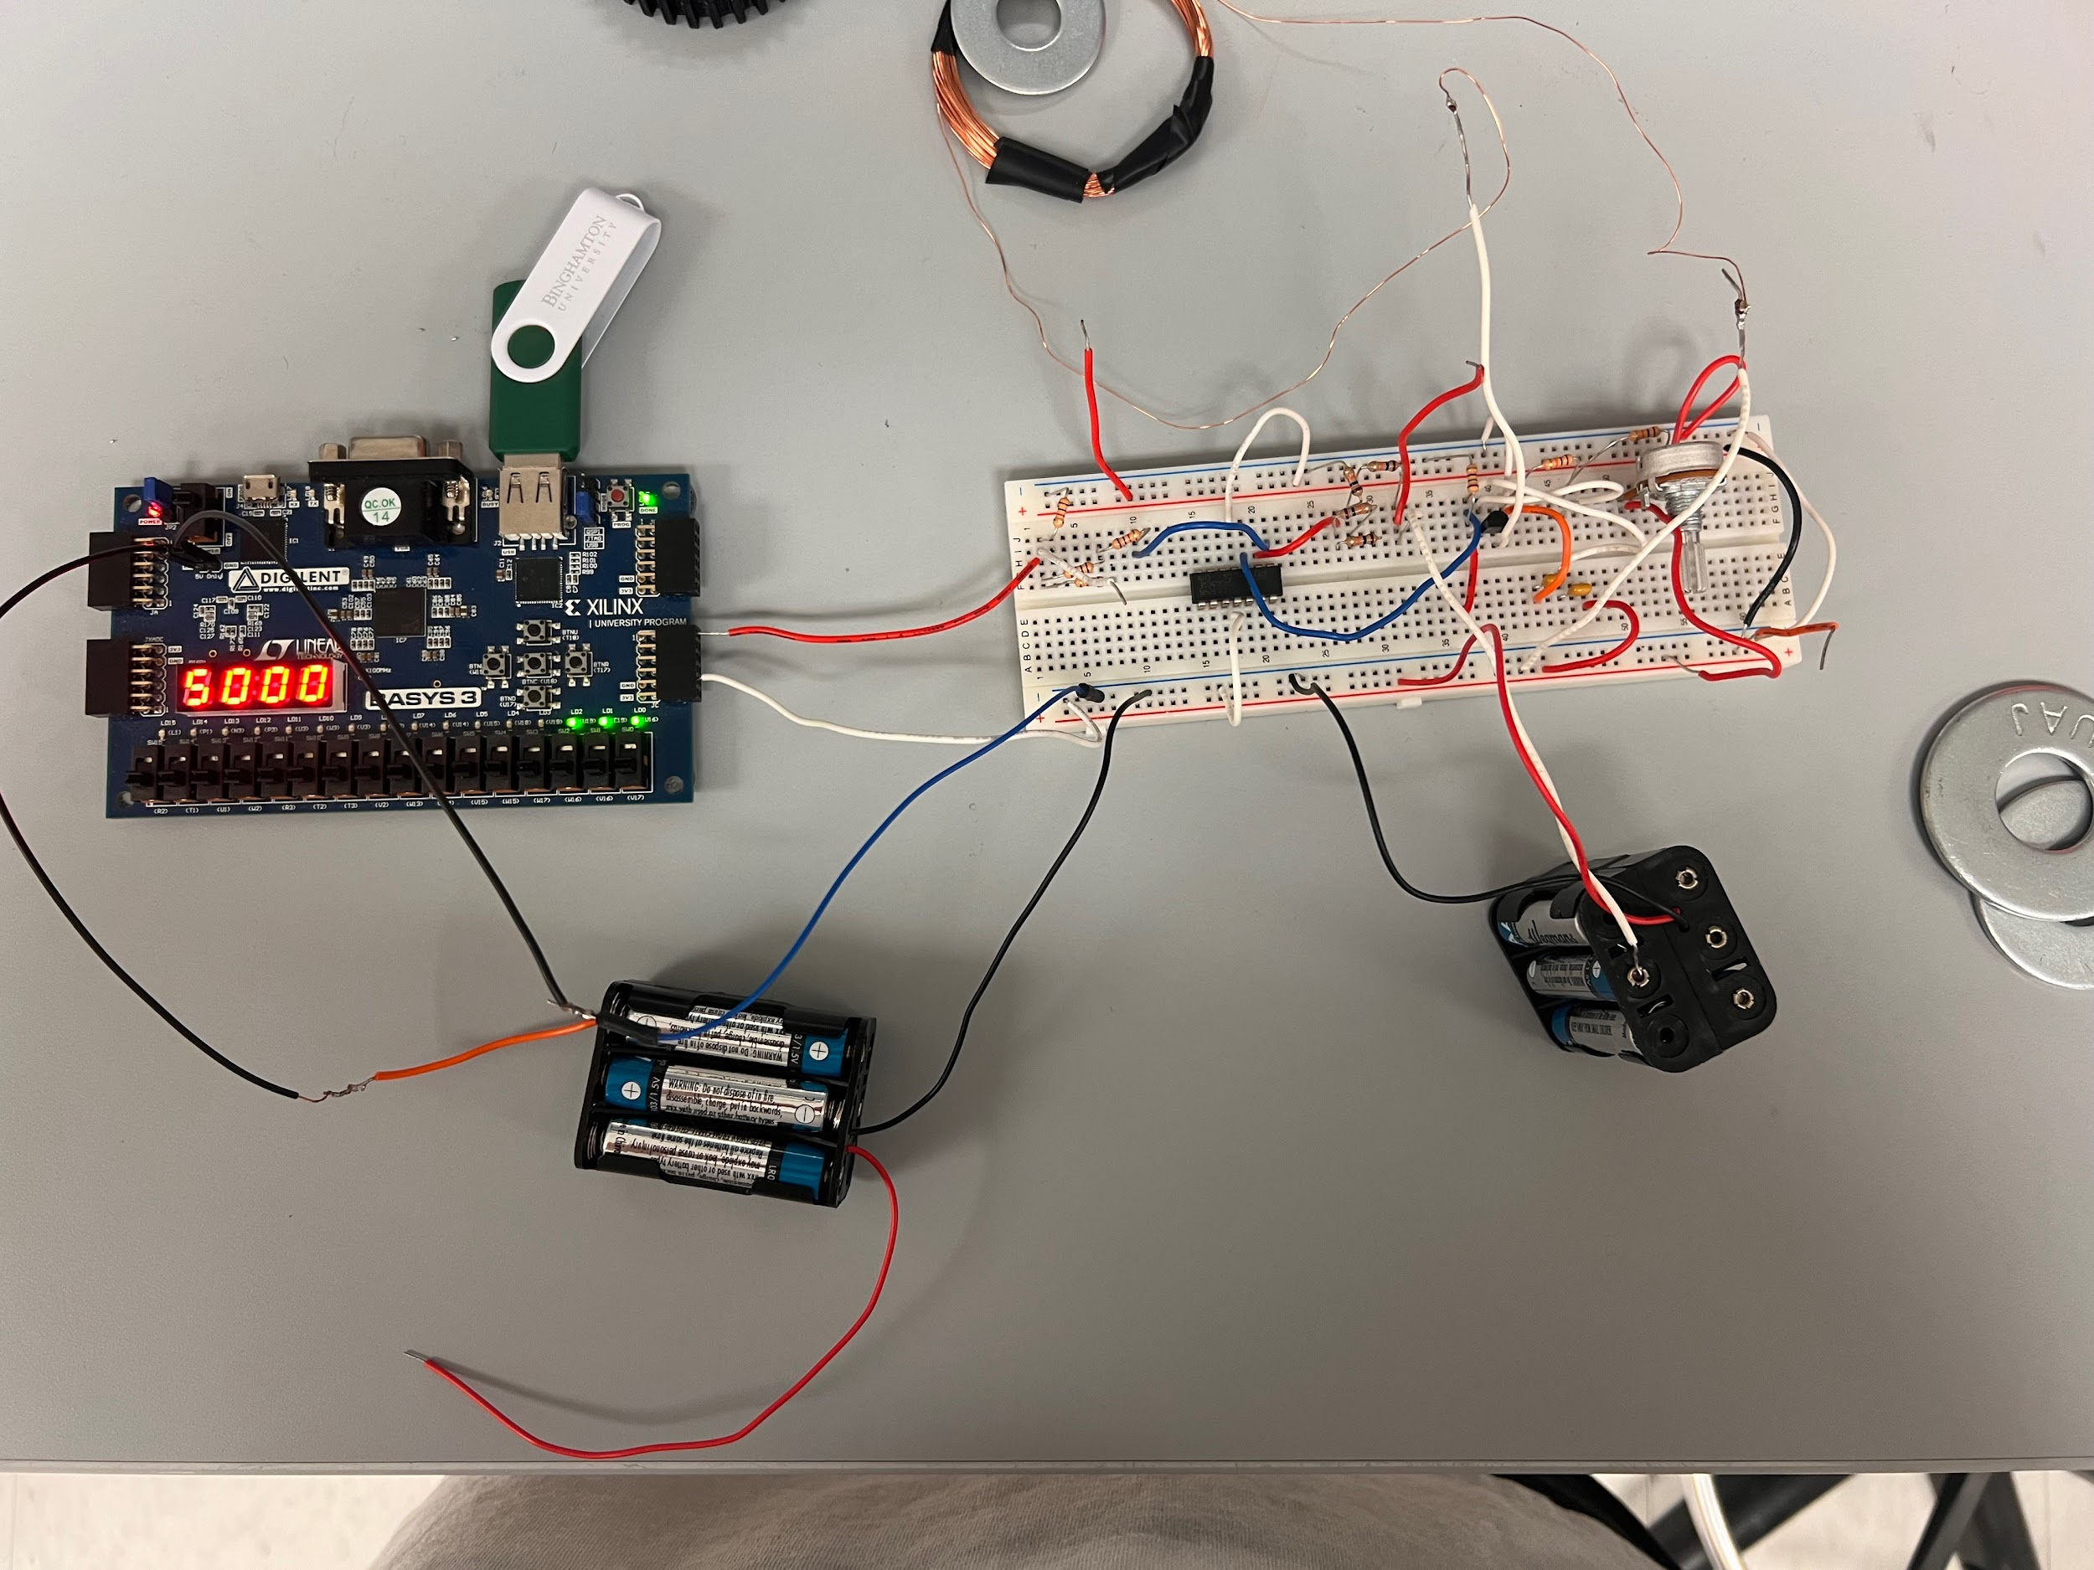
Small Washer

Slide 12
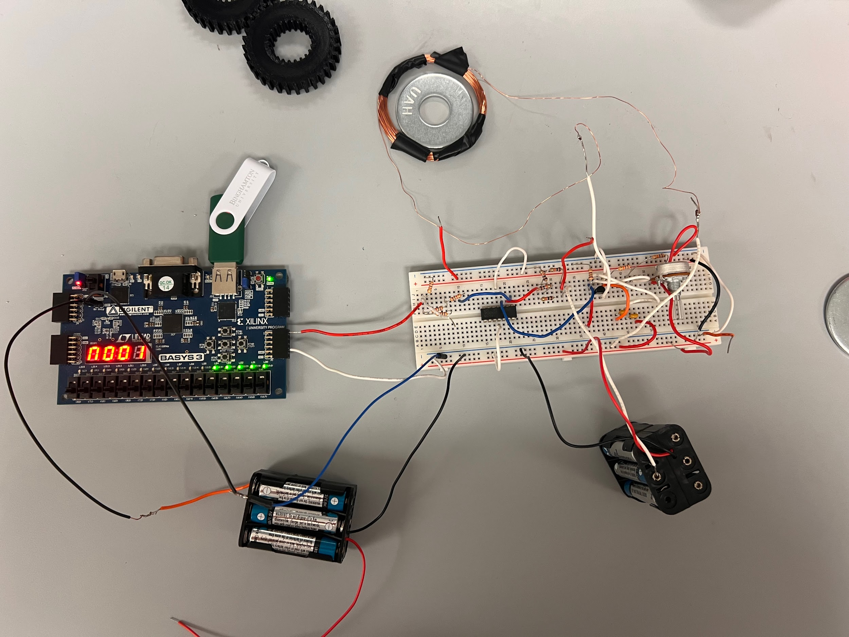
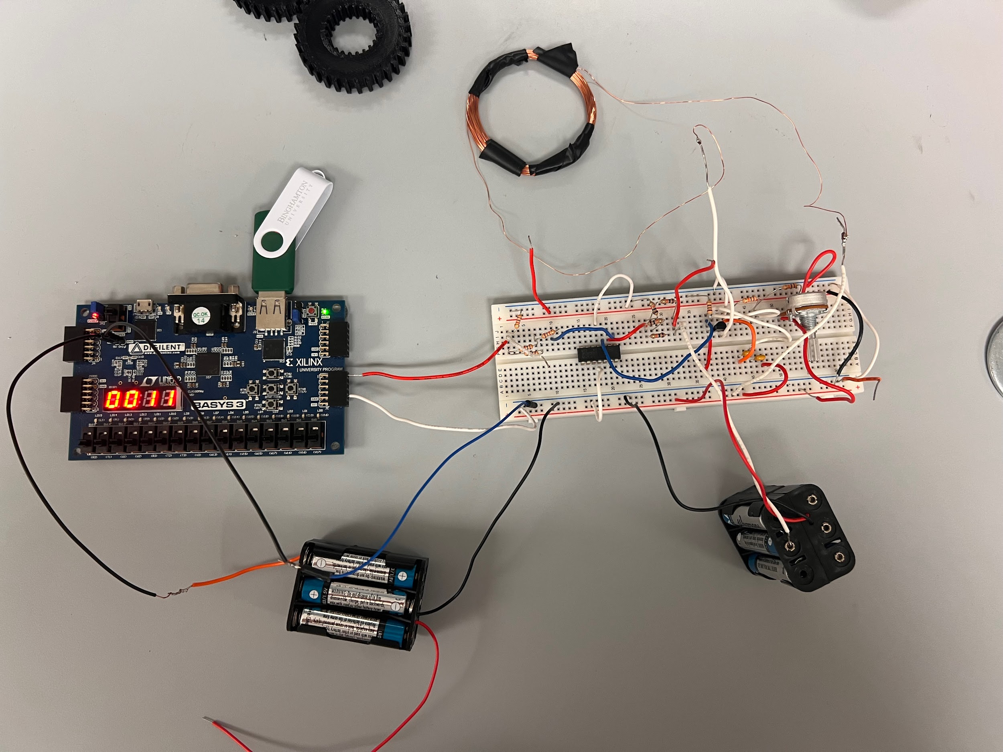
Medium Washer

Slide 13
Large Washer

Slide 14
Total Counter

